Slide 1
Analysis of Cache Design Choices and their Impact on Performance of 8086 microprocessor using Gem5 simulator
Team Members:
Rubina Parveen (RXL220014)
Neha Gangalapudi (NXG220043)
Allocate Marks (100/100)

Slide 2

What is Cache ?
It is smaller and faster memory that stores frequently accessed data or instructions
It reduces the memory access time of the processors.
There could be multi-level caches (L1, L2) in a processor each with different speeds, sizes and access times.
In multilevel cache hierarchy the L1 is the smallest but fastest cache located on the same chip as the processor.
L2 is larger and slower, can or can’t be on the same chip as the processor.
Caches help improve the overall speed and efficiency of a computer system by reducing the time to access data and instructions

Slide 3
Project requirements and Specifications
Objective
To optimize the cache hierarchy in X86 architecture on Gem5 simulator by changing parameters of cache design like cache size, associativity, etc.
Tools Used
Gem5 simulator on the university server
MobaXterm: For remote SSH extension to access Gem5 over university server
Benchmarks: (1)401.bzip2 (2) 429.mcf (3) 456.hmmer (4) 458.sjeng (5) 470.lbm
Shell Script: Created a shell script new_final.sh for the project

Slide 4
Deliverables
Calculate the CPI for a set of benchmarks
Optimize CPI for each benchmark
Define a cost function for the caches
Define an Evaluation function using CPI and Cost function
Graph of CPI vs Cost for designs

Slide 5
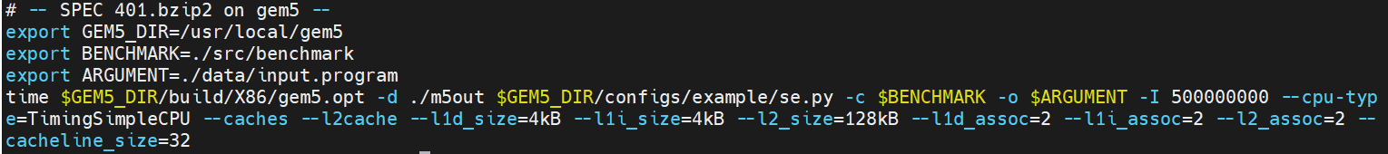
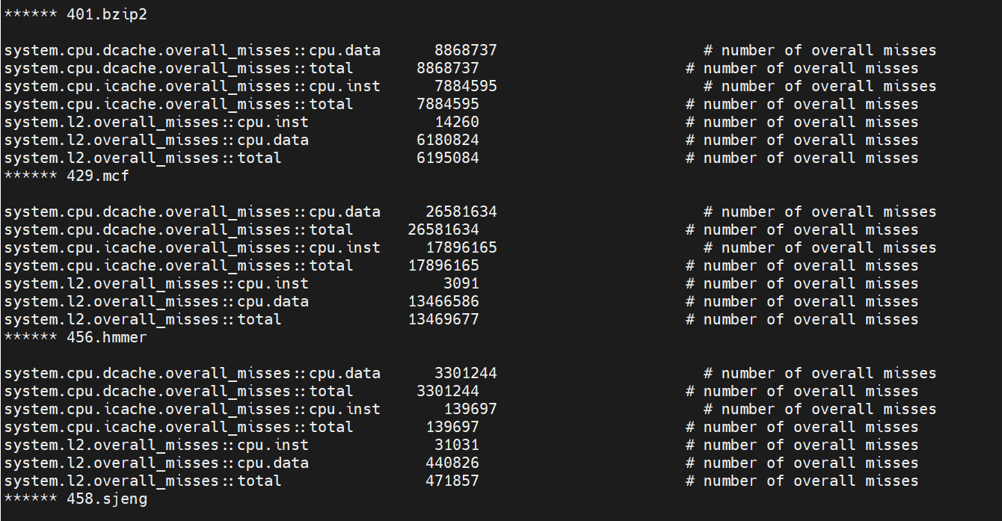
calculate CPI
We made the following changes to the respective “runGem.sh” files for the Benchmarks 401.bzip2, 429.mcf, 456.hmmer, 458.sjeng and 470.lbm and then runGem.sh.
We copy the values to a separate file and calculate the CPI for each benchmark.

Slide 6
Clock CYCLE Per Instruction (CPI) Calculations
Measures efficiency of a processor in executing instructions
It is a unit of measurement of the performance of a CPU.
The lesser the CPI the better is the performance of a CPU.
Benchmark 401.bzip2
system.cpu.dcache.overall_misses::total | 2403194
system.cpu.icache.overall_misses::total | 312
system.l2.overall_misses::total | 1304079
CPI = 1 + (((240394+312)*6)+(1304079*50))/5*10^8 = 1.3329

Slide 7
Benchmark 429.mcf
system.cpu.dcache.overall_misses::total | 11603840
system.cpu.icache.overall_misses::total | 262
system.l2.overall_misses::total | 3921696
CPI = 1 + (((11603840+262)*6)+(3921696*50))/5*10^8 = 1.5314
Benchmark 456.hmmer
system.cpu.dcache.overall_misses::total | 35948
system.cpu.icache.overall_misses::total | 487
system.l2.overall_misses::total | 1981
CPI = 1 + (((35948+487)*6)+(1981*50))/5*10^8 = 1.000635
Benchmark 458.sjeng
system.cpu.dcache.overall_misses::total | 2193581
system.cpu.icache.overall_misses::total | 513
system.l2.overall_misses::total | 2162869
CPI = 1 + (((2193581+513)*6)+(2162869*50))/5*10^8 = 1.2426

Slide 8
Benchmark 470.lbm
system.cpu.dcache.overall_misses::total | 1967883
system.cpu.icache.overall_misses::total | 222
system.l2.overall_misses::total | 1967092
CPI= 1 + (((1967883+222)*6)+(1967092*50))/5*10^8 = 1.2203

Slide 9
CPI for each benchmark
Configurations Used:
CPU type used : Timing
Benchmarks | L1 d sizes range | L1 i sizes range | L2 sizes range | L1 i assoc range | L1 d assoc range | L2 assoc range | Cache size range
401.bzip2 | 4,8,16,32,64,128KB | 4,8,16,32,64,128KB | 128,256,512KB,1MB | 2,4,8 | 2,4,8 | 2,4,8 | 32,64,128,256KB
429.mcf | 4,8,16,32,64,128KB | 4,8,16,32,64,128KB | 128,256,512KB,1MB | 2,4,8 | 2,4,8 | 2,4,8 | 32,64,128,256KB
456.hmmer | 4,8,16,32,64,128KB | 4,8,16,32,64,128KB | 128,256,512KB,1MB | 2,4,8 | 2,4,8 | 2,4,8 | 32,64,128,256KB
458.sjeng | 4,8,16,32,64,128KB | 4,8,16,32,64,128KB | 128,256,512KB,1MB | 2,4,8 | 2,4,8 | 2,4,8 | 32,64,128,256KB
470.lbm | 4,8,16,32,64,128KB | 4,8,16,32,64,128KB | 128,256,512KB,1MB | 2,4,8 | 2,4,8 | 2,4,8 | 32,64,128,256KB

Slide 10
Graph of benchmark 401.bzip2

Slide 11
Graph of benchmark 429.mcf

Slide 12
Graph of benchmark 456.hmmer

Slide 13
Graph of benchmark 458.sjeng

Slide 14
Graph of benchmark 470.lbm

Slide 15
From the Graphs:
Observations:
CPI decreases as L1 & L2 Cache Size increases .
CPI decreases as L1 & L2 Associativity increases
As CPI decreases performance increases
Optimal configuration – lowest CPI
For 401.bzip2,
L1.d = 128kB, L1.i = 128kB, L2 = 1MB, L1.d Associativity = 4, L1.i Associativity =4, L2 Associativity = 4, Cache Size = 256. The CPI is 1.1317.
For 429.mcf
L1.d = 128kB, L1.i = 128kB, L2 = 1MB, L1.d Associativity = 4, L1.i Associativity =4, L2 Associativity = 4, Cache Size = 256; the CPI is 1.3792

Slide 16
For 429.mcf
L1.d = 128kB, L1.i = 128kB, L2 = 1MB, L1.d Associativity = 4, L1.i Associativity =4, L2 Associativity = 4, Cache Size = 256; the CPI is 1.3792
For 456.hmmer
L1.d = 128kB, L1.i = 128kB, L2 = 1MB, L1.d Associativity = 4, L1.i Associativity =4,L2 Associativity = 4, Cache Size = 256; the CPI is 1.0007.
For 458.sjeng
L1.d = 128kB, L1.i = 128kB, L2 = 1MB, L1.d Associativity = 4, L1.i Associativity =4, L2 Associativity = 4, Cache Size = 128 ; the CPI is 1.2422.
For 470.lbm
L1.d = 128kB, L1.i = 128kB, L2 = 1MB, L1.d Associativity = 4, L1.i Associativity =4, L2 Associativity = 4, Cache Size = 256 ; the CPI is 1.2201.

Slide 17


Cost function
Conditions considered for getting the Cost Function
Cost Function is directly Proportional to cache size; that implies larger the cache, higher the cost.
Cost function is directly proportional to the associativity of cache i.e. More the associativity higher the cost
L1 caches are costlier than L2 Caches therefore cost of L1 will be more.

Slide 18
L1 Cache: From the table, we can see that the cost of the Cache doubles when the Cache size doubles.
L1 Associativity: We can see from the table that direct mapped cache costs 1$ and as the associativity increases, the cost also increases.
L2 Cache: L2 Cache is relatively cheaper than L1. The cost doubles as the Cache size doubles.
L2 Associativity: We can see from the table that directly mapped cache costs 1$ and as the associativity increases, the cost also increases.
L1 Size | Cost
4KB | 4$
8KB | 8$
16KB | 16$
32KB | 32$
64KB | 64$
128KB | 128$
L1 Associativity | Cost
Direct mapped | 1$
2 | 7$
4 | 14$
8 | 28$
L2 Size | Cost
128 | 14$
256 | 28$
512 | 56$
1MB | 112$
L2 Associativity | Cost
Direct mapped | 1$
2 | 4$
4 | 8$
8 | 16$

Slide 19
401.bzip2: COST vs CPI
The configuration with the lowest cost CPI = 1.8205 [l1d_size = 4KB, l1d_size = 4KB, l2_size = 128KB, l1 d_assoc =2, l1 i_assoc = 2, l2_assoc = 2, cache size = 32]
Cost = 4+4+14+7+7+4= $40
The configuration for the lowest CPI = 1.1317 [l1d_size = 128KB, l1d_size = 128KB, l2_size = 1MB, l1 d_assoc =4, l1 i_assoc =4, l2_assoc =4, cache size =256]
Cost = 128+128+112+14+14+8 = $404
Optimal Configuration Cost CPI = 1.1406 [l1d_size = 64KB, l1d_size = 64KB, l2_size = 1MB, l1 d_assoc =8, l1 i_assoc = 8, l2_assoc = 2, cache size = 128]
Cost = 64+64+112+28+28+4= $300
429.mcf: COST vs CPI
The configuration with the lowest cost CPI = 2.8807 [l1d_size = 4KB, l1d_size = 4KB, l2_size = 128KB, l1 d_assoc = 2, l1 i_assoc = 2, l2_assoc = 2, cache size = 32]
Cost = 4+4+14+7+7+4= $40
The configuration for the lowest CPI = 1.3792 [l1d_size = 128KB, l1d_size = 128KB, l2_size = 1MB, l1 d_assoc =4, l1 i_assoc =4, l2_assoc =4, cache size =256]
Cost = 128+128+112+14+14+8 = $404
Optimal Configuration CPI = 1.4223 [l1d_size = 64KB, l1d_size = 64KB, l2_size = 1MB, l1 d_assoc =8, l1 i_assoc = 8, l2_assoc = 2, cache size = 128]
Cost = 64+64+112+28+28+4= $300

Slide 20
456.hmmer: COST vs CPI
The configuration with the lowest cost CPI = 1.08307 [l1d_size = 4KB, l1d_size = 4KB, l2_size = 128KB, l1 d_assoc = 2, l1 i_assoc = 2, l2_assoc = 2, cache size = 32]
Cost = 4+4+14+7+7+4= $40
The configuration for the lowest CPI = 1.0007 [l1d_size = 128KB, l1d_size = 128KB, l2_size = 1MB, l1 d_assoc =4, l1 i_assoc =4, l2_assoc =4, cache size =256]
Cost = 128+128+112+14+14+8 = $404
Optimal Configuration CPI = 1.0018 [l1d_size = 64KB, l1d_size = 64KB, l2_size = 1MB, l1 d_assoc =8, l1 i_assoc = 8, l2_assoc = 2, cache size = 128]
Cost = 64+64+112+28+28+4= $300
458.sjeng: COST vs CPI
The configuration with the lowest cost CPI = 3.2583 [l1d_size = 4KB, l1d_size = 4KB, l2_size = 128KB, l1 d_assoc = 2, l1 i_assoc = 2, l2_assoc = 2, cache size = 32]
Cost = 4+4+14+7+7+4= $40
The configuration for the lowest CPI = 1.2422 [l1d_size = 128KB, l1d_size = 128KB, l2_size = 1MB, l1 d_assoc =4, l1 i_assoc =4, l2_assoc =4, cache size =256]
Cost = 128+128+112+14+14+8 = $404
Optimal Configuration CPI = 1.2514 [l1d_size = 64KB, l1d_size = 64KB, l2_size = 1MB, l1 d_assoc =8, l1 i_assoc = 8, l2_assoc = 2, cache size = 128]
Cost = 64+64+112+28+28+4= $300

Slide 21
470.lbm: COST vs CPI
The configuration with the lowest cost CPI = 2.5539 [l1d_size = 4KB, l1d_size = 4KB, l2_size = 128KB, l1 d_assoc = 2, l1 i_assoc = 2, l2_assoc = 2, cache size = 32]
Cost = 4+4+14+7+7+4= $40
The configuration for the lowest CPI = 1.2201 [l1d_size = 128KB, l1d_size = 128KB, l2_size = 1MB, l1 d_assoc =4, l1 i_assoc =4, l2_assoc =4, cache size =256]
Cost = 128+128+112+14+14+8 = $404
Optimal Configuration CPI = 1.4256 [l1d_size = 64KB, l1d_size = 64KB, l2_size = 1MB, l1 d_assoc =8, l1 i_assoc = 8, l2_assoc = 2, cache size = 128]
Cost = 64+64+112+28+28+4= $300

Slide 22
CONCLUSION
The CPI obtained from the benchmark 456 is better than the CPI obtained from the any other benchmark for all the configurations.
As the block size of the cache increases, CPI decrease and the performance increases.
As associativity increases, the CPI decreases.
The CPI obtained after the tradeoff with cost is 1.0018.
The cost of the CPU increases as the CPI decreases.

Slide 23
Graphs Cost vs CPI

Slide 24
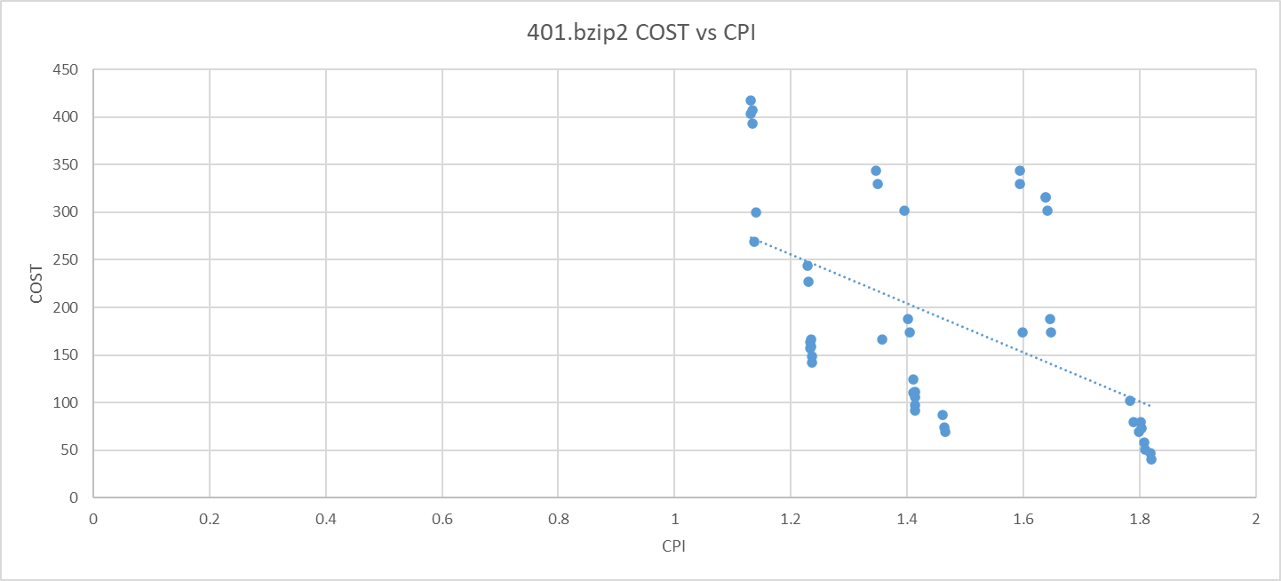
Graph of Cost vs CPI for benchmark 401.bzip2

Slide 25
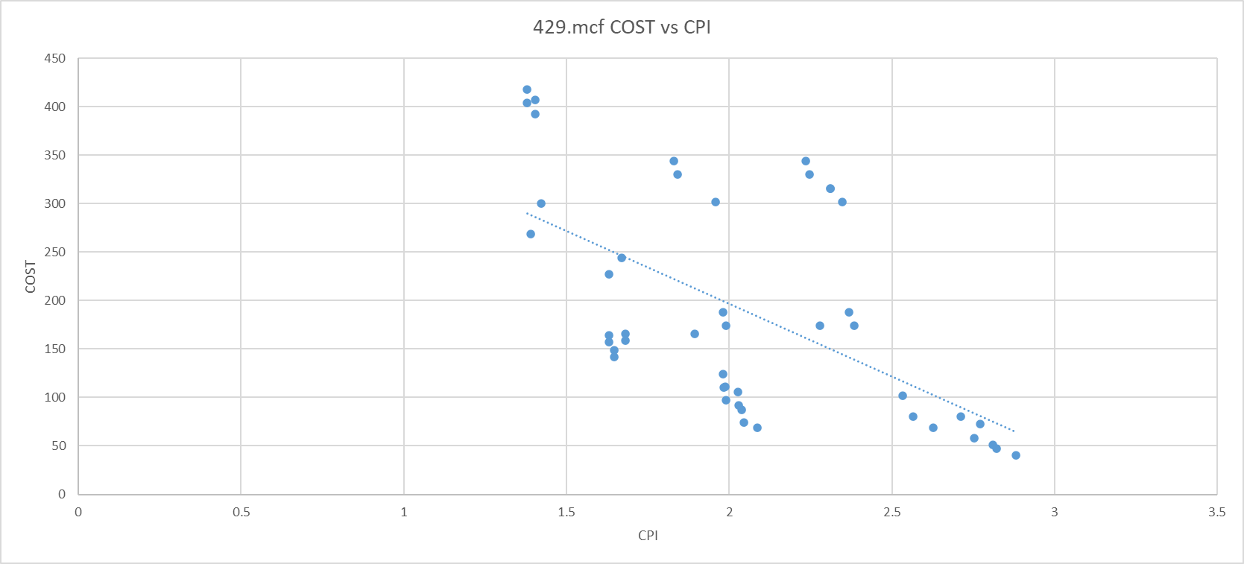
Graph of Cost vs CPI for benchmark 429.mcf

Slide 26
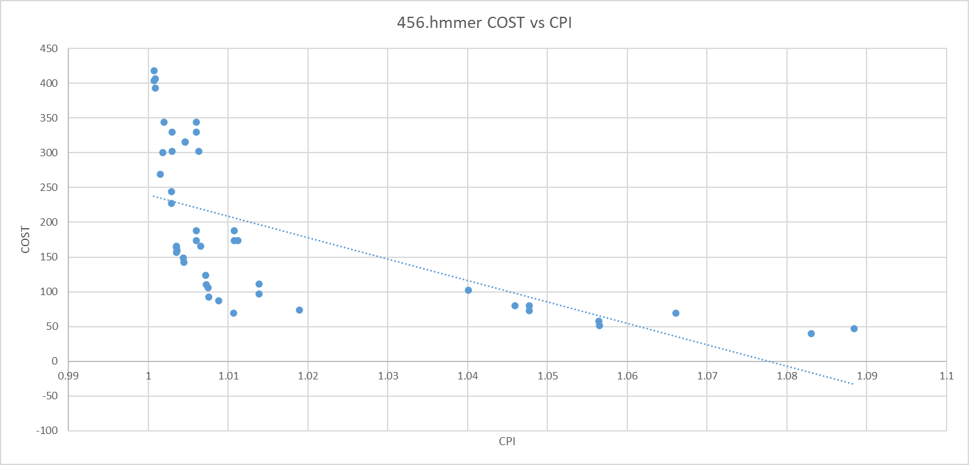
Graph of Cost vs CPI for benchmark 456.hmmer

Slide 27
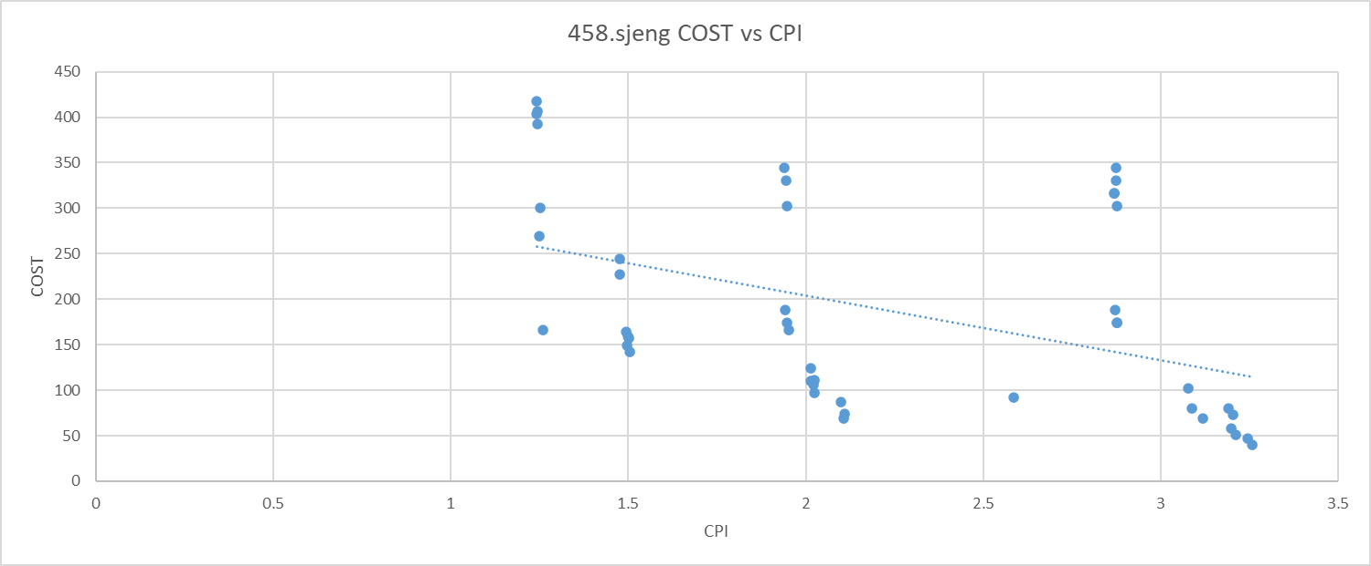
Graph of Cost vs CPI for benchmark 458.sjeng

Slide 28
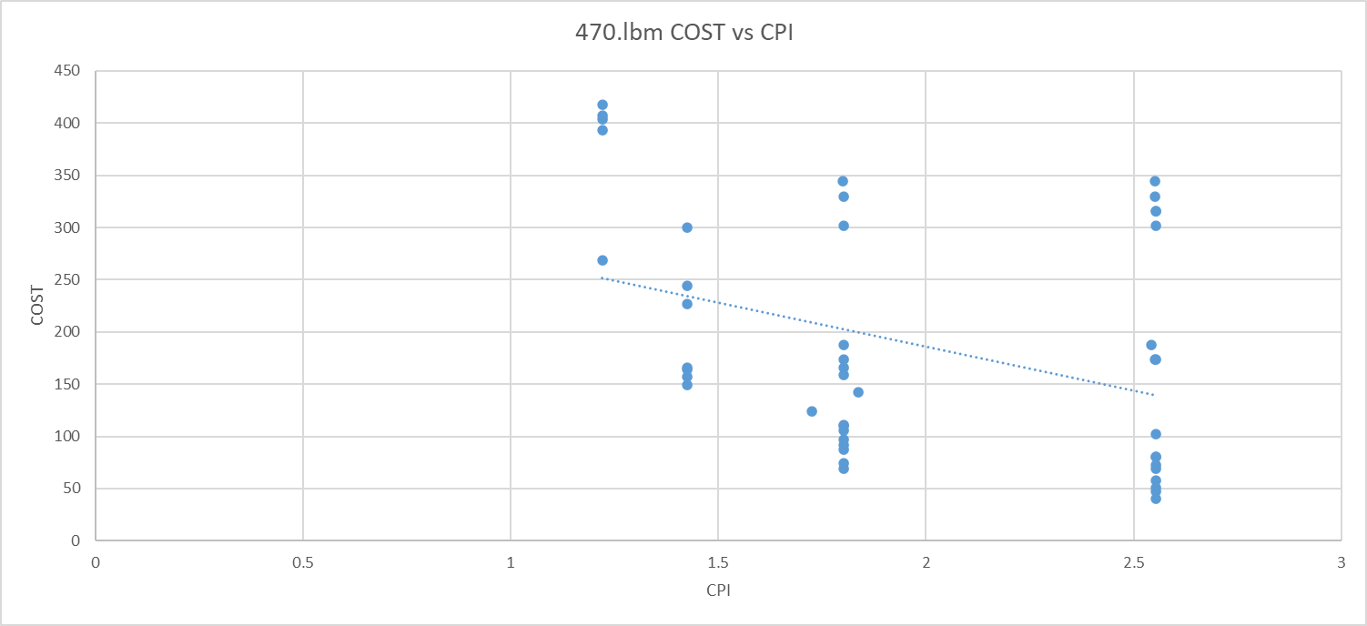
Graph of Cost vs CPI for benchmark 470.lbm

Slide 29
Evaluation conclusion
After evaluation of the CPI and Costs for the 5 benchmarks we observe that the benchmark 456.hmmer is giving us the lowest CPI of 1.007 at cost $404.
After the tradeoff between the CPI and Cost we get that we are getting a CPI closer to the lowest CPI with lesser Cost.
Therefore, the Optimal value of CPI is 1.0018 for a cost of $300 as per the graph for benchmark 456.hmmer

Slide 30
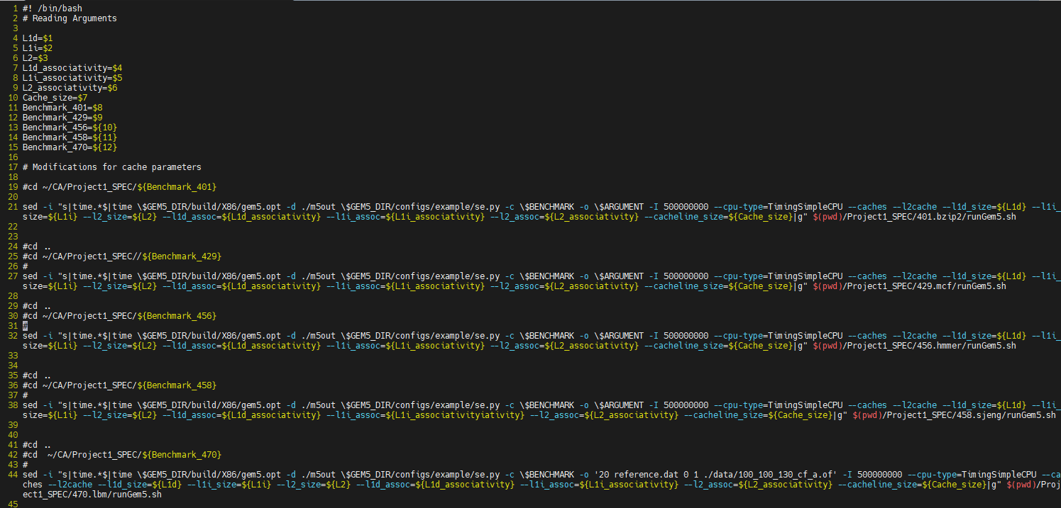
Appendix
Steps taken for the execution
Shell script for the automation of the execution of all the 5 benchmarks.

Slide 31
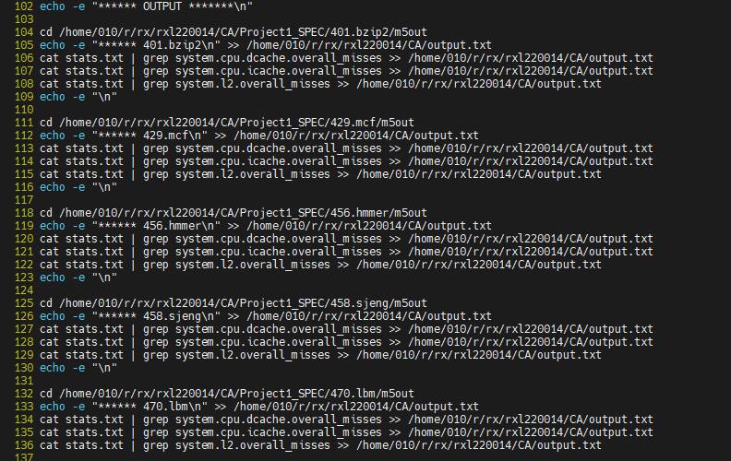
2. created an output.txt file to get the results

Slide 32
Gave arguments in the command line
We executed for 45 configurations and have calculated the CPIs and Cost functions in an excel sheet (Project Output_New).

Slide 33

Thank You

